Slide 1
^^
^^
PONG
PLAYER 1
PLAYER 2
– DEPOSIT QUARTER
– BALL WILL SERVE AUTOMATICALLY
– AVOID MISSING BALL FOR HIGH SCORE
syzygy engineered
Atari INC.
Santa Clara, Ca.
„Production“ version.
To print, disable "scale to fit paper" in Powerpoint! (Print options, "full page slide"... ).
Yellow = R255 G240 B0, Aluminum Texture Brightness +20%

Slide 2
^^
PONG
PLAYER 1
PLAYER 2
– DEPOSIT QUARTER
– BALL WILL SERVE AUTOMATICALLY
– AVOID MISSING BALL FOR HIGH SCORE
syzygy engineered
Atari INC.
Santa Clara, Ca.
Mockup incl. knobs.
To print, disable "scale to fit paper" in Powerpoint! (Print options, "full page slide"... ).
Yellow = R255 G240 B0, Aluminum Texture Brightness +20%

Slide 3
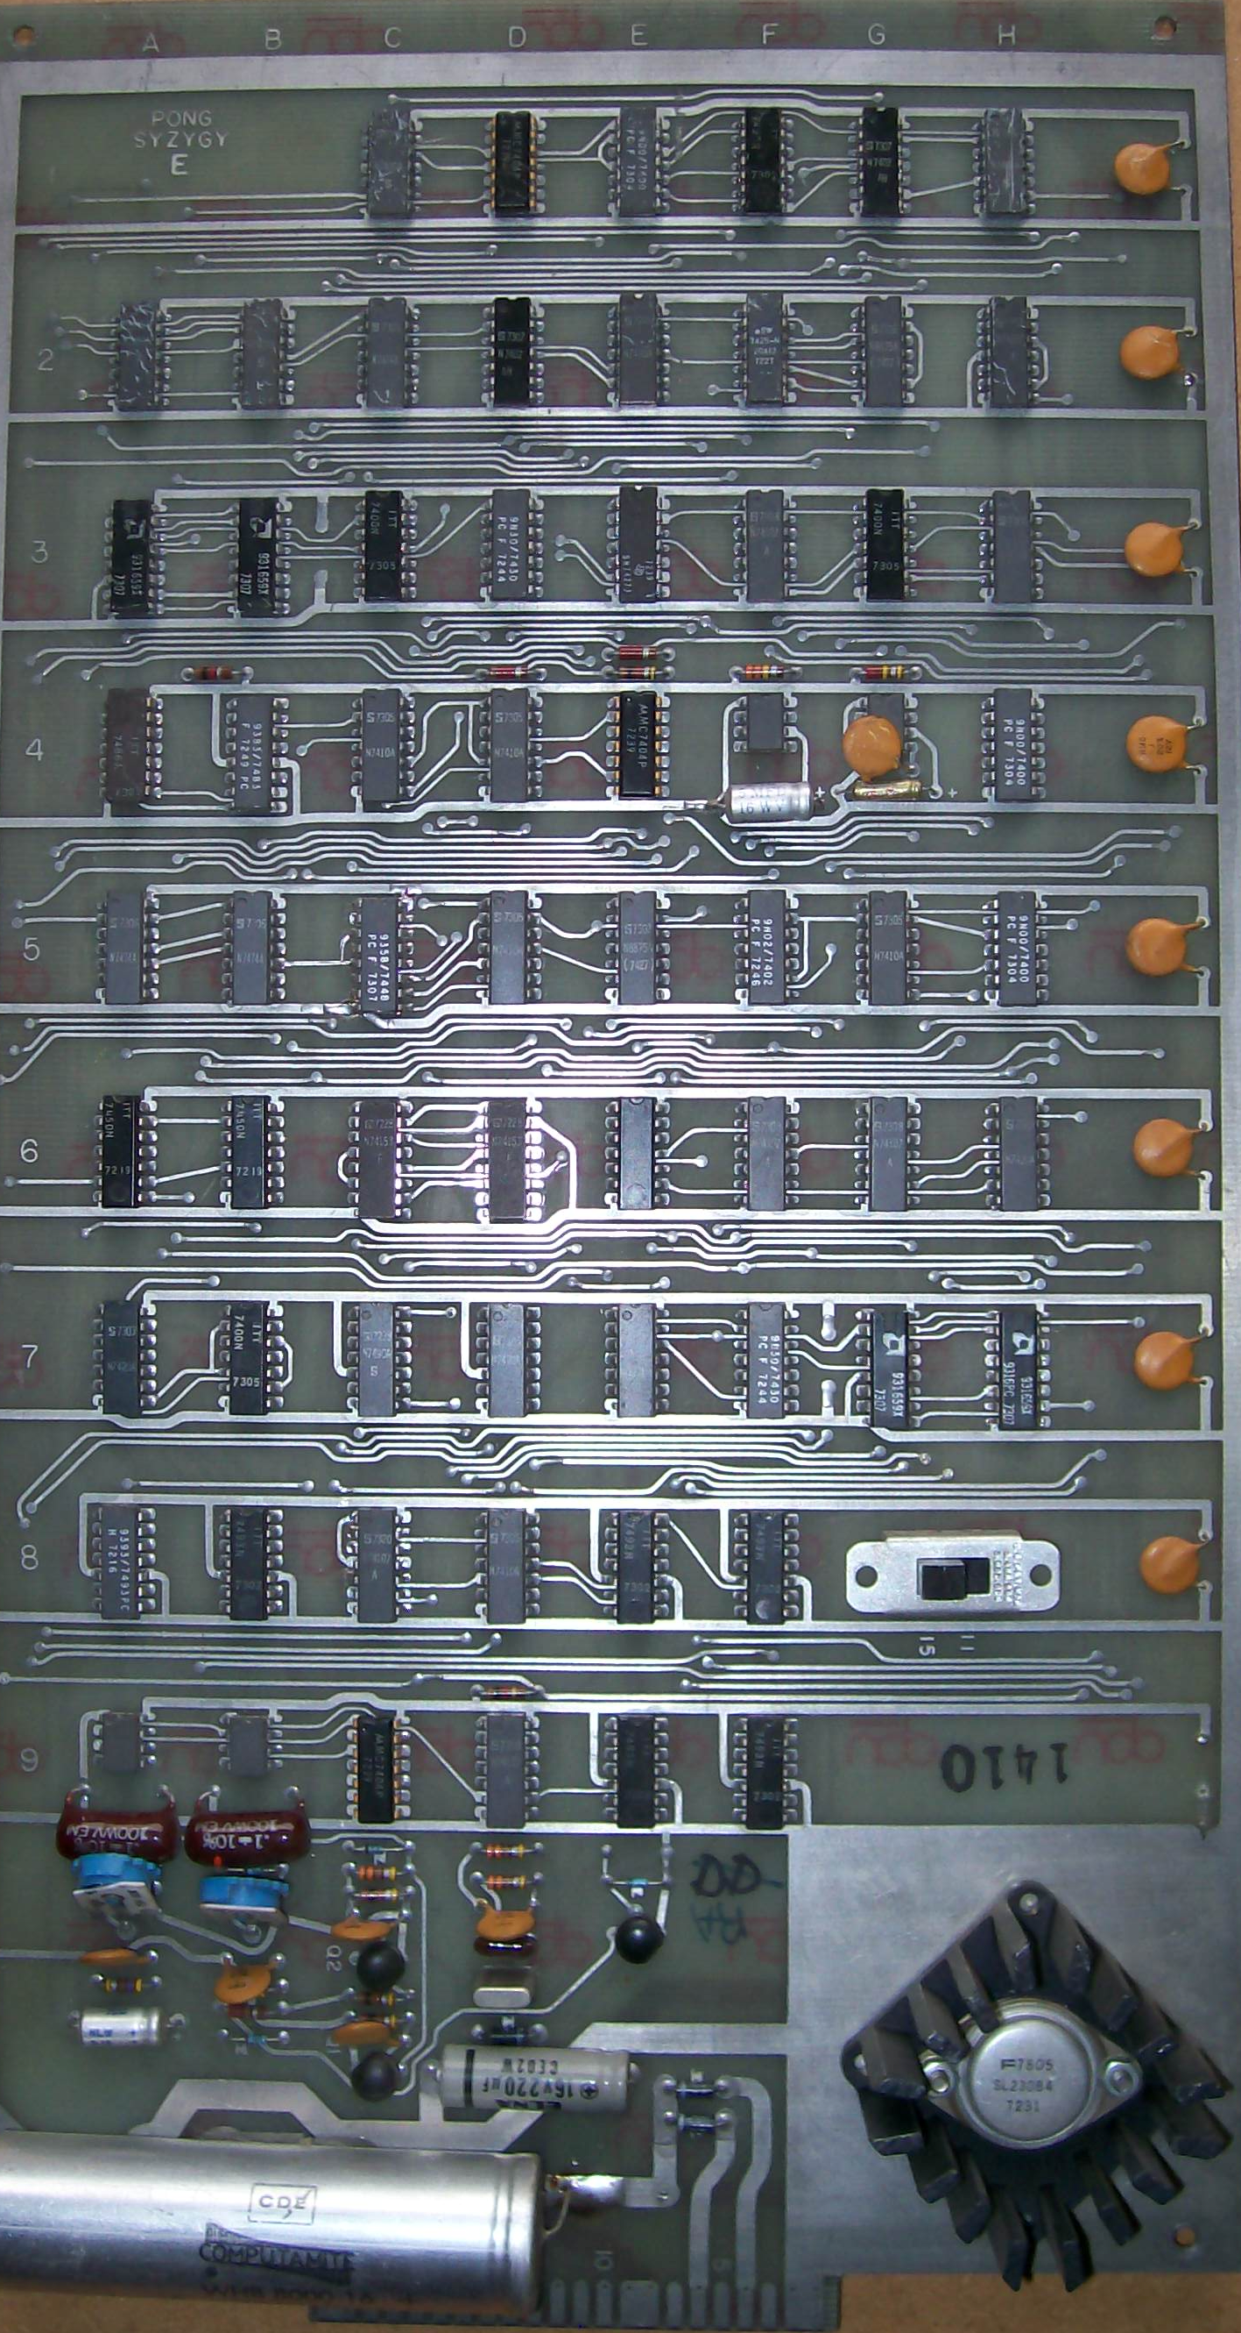
^^
– DEPOSIT QUARTER
– BALL WILL SERVE AUTOMATICALLY
– AVOID MISSING BALL FOR HIGH SCORE
syzygy engineered
Santa Clara, Ca.
74.0 cm
29. 2cm

